Slide 1

Context Aware Ontologies
Contexts for Integration and Interoperability
Ontolog Ontology Summit 2018
Contexts in Context
Cory Casanave
Model Driven Solutions
Cory-c (at) modeldriven.com
Context aware ontologies for information and system integration
Jan 30, 2018
Copyright © 2018 Model Driven Solutions, Inc.

Slide 2
Problem Statement
Focus: Integration, Interoperability and Federation Leveraging Reference Ontologies*
Every major enterprise needs to integrate and federate information and systems, internally and externally
Current manual methods are costly, time consuming and error prone. They tend to tie the enterprise system of systems into a complex, anti-agile Gordian knot
These many systems are independently conceived, each containing multiple separate definitions of the same or overlapping concepts. These definitions are technology, organization and application specific
Semantic mediation as been a primary value proposition for Ontologies, but has proved difficult, particularly for systems without a formal underpinning – which is 99.9% of the systems
Our proposition is that successful semantic mediation requires context. Ontologies to solve these problems must be context aware.
Being Context aware requires a level of granularity beyond contextualizing ontologies
* Reference Ontology: A set of concepts intended to be referenced by multiple designs, ontologies and schema in support of integration and interoperability among them.
Different from: Application Ontology, intended to support reasoning in support of a particular application.

Slide 3
What is context?
A context is anything that impacts the interpretation or truth value of something else
There are different kinds of context, contextual dimensions. Kinds of context include
Time – fundamental to our understanding of the world is that things change. Most relationships and other assertions are only meaningful in the context of a timeframe
Sue’s weight was 50kg on July 1st, 2017
Barack Obama was president of the United Stated 2/20/2009 until 1/20/2017
Occurrences (perdurants) – things that are only true while something is happening
The radar’s range will be reduced while it is raining
States - things that are only true when something is in a particular condition
Food services will be reduced when the power is off
The computer is vulnerable when it is connected to the internet
Authority - things that are only true within the jurisdiction of some authority (including geopolitical)
Radar detectors may not be used within Virginia
“Fairfax” is the name of a City in Virginia
Interaction - things that are only true when communicating for a purpose
Mortgage loan applications must include name, address, SSN and current income

Slide 4
More Contextual Dimensions
Social Group – things that are true for a set of people
In French, Germany is called “Allemagne”
Location – things that are true in a particular place
The acceleration of gravity is 9.8 m/s² on the surface of the earth
Type – things that are true for kinds of things
Mammals have hair
System – things that are true within a specific system
Reactor 5, pump A6 is failing
Design – things that are true for a design
The victim database contains the victim’s current address and phone number
Source (Provenance) – things that are true within a text, speech act or ontology
John’s report said “Reactor 5, pump A6 is failing”
Others – there are many contextual dimensions
Things may be in multiple context at the same time
“An Ontology” or theory as a course grain context

Slide 5
A theory of contextualization
Contextual dimensions are types of context
E.g. U.S.A. is a kind of Geopolitical Organization
Geopolitical Organization is a kind of context
Contexts contextualize things that have that context
<Thing> has context <Context>, or <Context> contextualizes <Thing>
E.g U.S.A. contextualizes Alaska
But, that isn’t specific enough
Relationships define contextualization for a contextual dimension
(<Geopolitical Entity> governs <Region>) specializes (<Context> contextualizes <Thing>)
E.g. (U.S.A. governs Alaska) implies (U.S.A. contextualizes Alaska)

Slide 6
Higher Order Context
Context, such as time, can apply to other statements
<Actual Situation> exists for <Time Interval>
(U.S.A. governs Alaska) exists for March 30, 1867 to Unknown
(U.S.A. governs Massachusetts) exists for March 4th, 1789 to Unknown
Rights and Obligations are frequently contextual
Citizens of the U.S.A. have right Protections from Unreasonable Searches and Seizures
exists for March 4^{th,} 1789 to Unknown
(Workers in the U.S.A. must pay Income Tax) exists for Feb. 3rd, 1913 to Unknown
Implies
Since March 30, 1867 Citizens of Alaska have rights and as of Feb. 3rd, 1913 must pay taxes

Slide 7

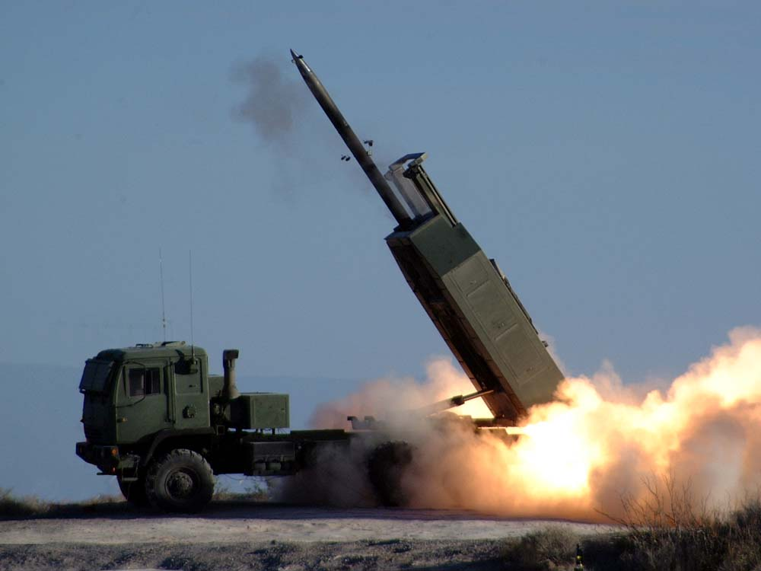
Ignoring of context is dangerous!
Test Scenario : Control Systems
Launch
Missile
Issues with ignoring context when integrating or federating information or processes
Improper integration of information from different timeframes
That prescription was for last year!
Failure of trust – what information is to be trusted and why
We listen to their feed, but it is all lies
Violation of compliance, rules are contextual
You stored that information in the EU?
Consider: “Launch Missile” Vs. Test: “Launch Missile”
Sorry Korea!
Oops!

Slide 8

Context to bridge Reference Concepts and Data
Mass/weight in data elements
May have different labels
Use different units
May be required, optional or excluded
May be past, current, expected, recommended or allowed
May be represented using various data types (int, real, string, etc)
But it’s the same mass of the same individual!
Humans share a concept of “mass/weight” – all physical things have a mass

Slide 9
Why would two mappings of the same data on the same day be different? Why would the fields not be the same?
Automated
Information
Translations
Bethesda Hospital Records
Army Reserve Fitness Report
Sue’s Fitness Report
LegalNameString: Sue Plankton
Birth: January 15th, 1968
PersonMassKG: Unknown
PersonBloodPressue: Unknown
Report Date: Jan 10th, 2018
Sue’s Physical Report
Name: Sue Plankton
DOB: January 15th, 1968
SSN: 390-55-8967
Weight: 134 lbs
BP: 122/78
Physical Date: June 3, 2017
?
Job Application for Fun Fitness Centers
Sue’s Job Application
PNAME: Sue Plankton
PBD: January 15th, 1968
Social: 390-55-8967
CWeight: 134 lbs
AppDT: Jan 10th, 2018
Sue’s Home Scale
Weight: 131 lbs
Taken: Dec 3, 2017
How are multiple sources reconciled?

Slide 10
Context determines terms & representation (of data) for concepts
Mapping Context
Context:Physical Report
Reference Context: Concept Library
Context:Fitness Report
Name
Person Name
LegalNameString
Textual Representation
DOB
Structured Representation
Birth Date
Birth
XSD Representation
Weight
Actual Mass
PersonMassKG
Unit: Pounds-Mass
Unit: KG
Ontological reference concepts, can serve as a pivot-point between different data representations, or different ontologies. This can power automation of interoperability, integration and federation.

Slide 11

Context of time and data determine data interoperability
Weight measurement is in the context of the physical’s date
Example data rules (data context)
Army Reserve Fitness Report must include Name, DOB, May include Weight and BP if known.
Job Application for Fun Fitness Centers must include name, DOB, SSN & Weight
Example business rules (mapping context)
Army Reserve: Recording of a solders weight must be based on a measurement within the last 60 days.
Fun Fitness Centers: Recording of weight must be reported from last physical
Ontologically, all living humans have a weight. The concept of weight may be used to ground data in multiple repositories – great!
Rules for business and data context impact data mappings and therefor interoperability.
Understanding context and their implications is crucial.
Why the same data on the same day be different in different context

Slide 12

Location Context
Rule:
1KG= 2.204+-0.015 lbs
Holds
within
On the surface of the earth, weight and mass are convertible
The surface of the earth provides a location context for the rule:
One Kilogram is equal to approx. 2.20 Pounds
Context: Surface of the Earth
Sue’s Home Scale
Weight: 134 lbs (Integer)
Sue’s Fitness Report
PersonMassKG: 60.78 (Real)

Slide 13
Concept of Context
Reminder
A context is anything that impacts the interpretation or truth value of something else
“Propositions” are the interpretations/truth values. “Things” are the something else.
Proposition/rule
holds within
Context
contextualizes
Thing
asserts
has context
Propositions that hold within a context hold for all things the context contextualizes

Slide 14
Context as predicates
A context be false
E.g. It is not 2017 or we are not on the surface of the earth.
If a context is false, propositions do not hold for what the context contextualizes
True
Proposition/rule
holds within
Context
contextualizes
Thing
Implies
Context(x) implies propositions that hold within x hold for all things x contextualizes

Slide 15
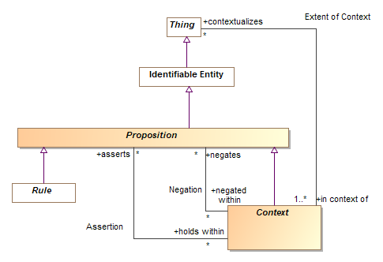
Candidate Context Model*
Semantic Modeling for Information Federation (SMIF) conceptual model

Slide 16

History Happened
Many DBMS (and many ontologies!) only consider the “current state”
the past is just as important
It will always be true that:
Barack Obama was president of the united states Jan 20 2009-Jan 20, 2013.
Donald Trump is/was president of the united states Jan 20 2013-Unknown.
Sue weighted 134 lbs on June 3th 2017
Historical statements can be just as important as current statements
Time is a context for when any assertion is made and the timeframe for which it is applicable
Different data context will have different assumptions about time and history
Multiplicity and time
Consider the impact on multiplicity: A person only has one weight (at a time) but will have many weights that include time context.
But, a person only has one brain, for all time
Multiplicity constraints should differentiate: at a time Vs. for all time

Slide 17
Situations as Context
Actual situations
(& relationships* ) are temporal
Situations can be aggregates – assert
other situations
Sue’s Stolen key-card vulnerability situation
Exists for
Sue’s permission situation
Sue has permission to enter building-5
Atomic situations are
Material or Descriptive relationships*
Timeframe
Jan-1 2005 to Jan 1 2007
Key-card a5-347 situation
Key-card a5-347 is a credential for Sue’s permission
Exists for
Timeframe
Feb-1 2005 to Feb 15th 2005
Key-card stolen situation
Sue’s key-card a5-347 was stolen
Exists for
Timeframe
June-1 2005 to Feb 15th 2005
Timeframe
Feb-1 2005 to Unknown
Exists for
Situations involve (contextualize) other, related things.
* “Material relations & relators”, see: https://inf.ufes.br/~gguizzardi/AI_IA2016.pdf

Slide 18
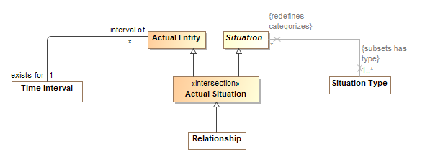
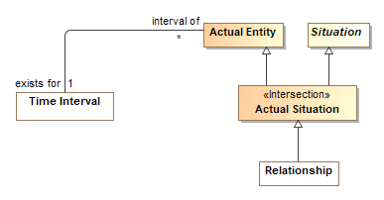
Candidate Situation Model*
As with all things, situations have types describing their nature
Semantic Modeling for Information Federation (SMIF) conceptual model

Slide 19
Type as Context
Types categorize things of that type
Categorizes is a sub-property of contextualizes
A set of propositions hold for a type
This set of propositions hold for all things categorized by a type
“Type” can be modeled as a subtype of “Context”
contextualizes
All living persons have a living brain
holds within
Living Person Type
categorizes
Sue
asserts
has type
has context
Note: Not all rules about living persons are in the context of the type, consider hospital rules.

Slide 20
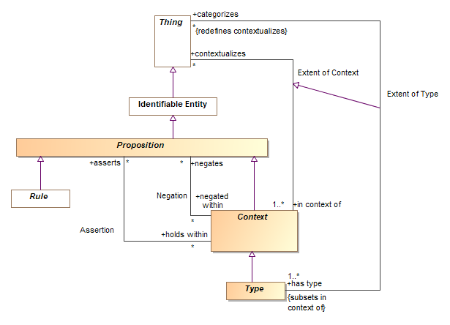
Candidate Type as Context Model

Slide 21
Perspectives and Context
A perspective selects which context are true, for that perspective
E.g. a perspective can establish timeframe and the set of applicable (asserted) ontologies
A perspective can order context by precedence, to resolve conflict
E.g. a perspective can order ontologies of preferred terms, perhaps French first and English second.
A perspective is, its self, a context
Context hold within a perspective
Context
Context
Perspective
Context
holds within
Precedence
holds within

Slide 22
Perspectives May Include Time
implies
True
Sue’s
Historical Perspective
Sue’s permission situation
Sue has permission to enter building-5
holds within
implies
Exists for
True
Exists for
Timeframe
Jan-1 2005 to Jan 1 2006
Timeframe
Jan-12 2005

Slide 23
Relationships as Context
Sue is an authorized actor in the context of the permission to enter building 5
Sue
binds
Authorized Actor
Property type
Bound by
Permission Relationship Type
Has type
Sue’s permission
Sue has permission to enter building-5
Permitted Action property type
Bound by
binds
Property
Binding
Enter building 5 is a permitted action in context of Sue’s permission
Enter building 5 activity

Slide 24
Context, Perspective & “Higher Order” Logics
Context and perspectives introduce higher order relations
Many reasoning systems are FOL only, how can we reason about context?
Option 1 Use a rules approach
Option 2 Use a higher order logic
Option 3 Pre-compute the context
Asset perspective
Derive “true” context, recursively
Export context-free (FOL) ontology
Infer exported ontology using FOL
Our focus is reference ontologies, application ontologies have different (and usually more complex) reasoning requirements – a rules approach seems most applicable.
We can build a model and implement this program, can we formalize the semantics?

Slide 25
References
Relationships and Events: Towards a General Theory of Reification and Truthmaking
Nicola Guarino, Giancarlo Guizzardi
https://inf.ufes.br/~gguizzardi/AI_IA2016.pdf
Situation Semantics
See references in John Sowa’s presentation
http://jfsowa.com/ikl/contexts/contexts.pdf
Semantic Modeling for Information Federation (SMIF)
Needs an update, latest complete document:
https://github.com/ModelDriven/SIMF/blob/master/NextSubmission/SMIFSubmissionMasterDocument.pdf

